Slide 1
Sentiment Analysis
Professor: Sri Krishnamurthy
Team - 10
Team Members: Shashwat Mehra
Varsha Holennavar
Pooja Goyal

Slide 2
Why use Sentiment Analysis
The sentiment found within comments, feedback or critiques provide useful indicators for many different purposes which help in making well informed decisions.
Widely applied to reviews and social media for a variety of applications, ranging from marketing to customer service

Slide 3
What is Sentiment Analysis
The process of computationally identifying and categorizing opinions expressed in a piece of text, especially in order to determine whether the writer's attitude towards a particular topic, product, etc., is positive, negative, or neutral.
Refers to the use of natural language processing, text analysis and computational linguistics to identify and extract subjective information in source materials

Slide 4
Pre Processing in Sentiment Analysis
Noise Removal
Classification
Named Entity Recognition
Subjectivity Classification
Feature Selection
Sentiment Extraction

Slide 5
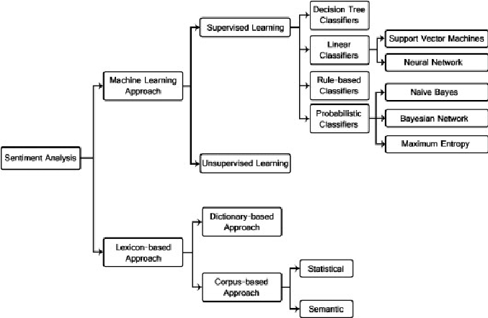
Sentiment Analysis Techniques

Slide 6
Demo
Demo 1 : Twitter Analysis using LEXICON Approach
Demo 2 : Twitter Analysis using Tableau
Demo 3 : Naive Bayes

Slide 7
Challenges in Sentiment Analysis
Context
Sentiment Ambiguity
Sarcasm
Language

Slide 8


